Slide 1
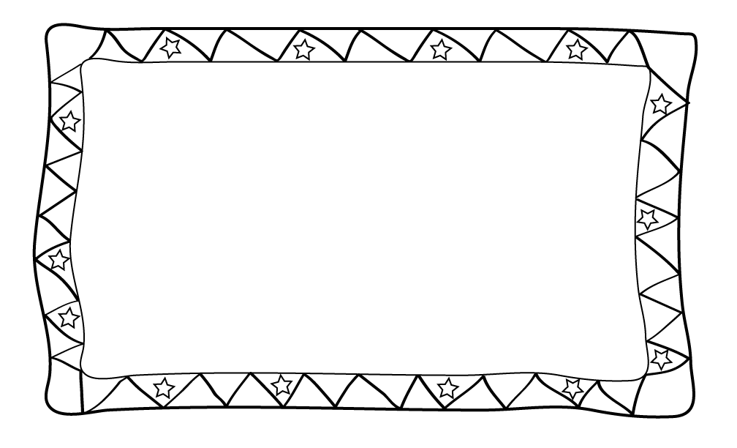
Flip Book
Transformation Project
Rotation
Translation
Reflection
Dilation
Notes:
http://www.graphicdesignbasics.com/2010/graphic-design-spotlight-animation-and-animators-part-i.html

Slide 2
FLIP BOOK PROJECT DUE: Monday September 11th
Flip books are something that dates back many years ago. Modern day animation is based on the flip book concept. A flip book is essentially a book that has still frames on each page. As you flip the pages of the book, the image moves. We will be creating a book on Google Slides to help us learn about transformations.
How to make the book on Power Point:
1) To access the template, go to http://kgrimmrhs.weebly.com
2) Decide on a narrative or storyline for your flip book.
3) Decide what you are going to draw to tell your story. Use the draw toolbar to enhance your drawings.
4) When you are ready to move to the next slide: right click and select “duplicate slide.”
Requirements:
Cover page
Narrative or storyline
Image/scene to make your narrative come to life!
Make your image move. Choose a row or column from movement chart (next slide). However, one additional movement must be a dilation
Choose a starting point on your image and track the movement of it using algebraic notation
You must have a minimum of 10 slides
Notes:
15 slides/ group.. 5 rows/ columns in chart.. 3 people per group…each person does one of each transformation in selected row/column.

Slide 3
Movement Chart
Your image must move in at least 4 ways. To decide how your image is going to move, choose a row or column from the chart below. CIRCLE IT. Your movements will be those that you circled.
Rotation (180 degrees about the origin) | Reflection Over x axis | Translation | Reflection over y axis
Reflection Over x Axis | Translation | Rotation (180 degrees about the origin) | Translation
Translation | Rotation (180 degrees about the origin) | Rotation (90 degrees about the origin) | Reflection Over y axis
Reflection Over y axis | Translation | Translation | Reflection Over x axis
Notes:
*change up that table so that every row/column/ diagonal has at least two isometries and one dilation?
*Make the table bigger so that it has more requirements?
*provide a minimum slide requirement?
*provide a suggestion for how many moving parts they must have in their flipbook?

Slide 4
Description of Movements
Here is an example of a chart to record the algebraic notation of your movements
 | Explain Location | Original Point | New Point | Actual Notation | Type of Transformation/Description
Slide 1-2 | Tip of nose | (9, 3) | (10, 1) | (x, y) → (x + 1, y + 2) | Translation: right 1, up 2
Slide 2-3 | Tip of nose | (10, 1) | (-10, 1) | (-x, y) | Reflection over y axis
Slide 3-4 | Tip of nose
Slide 4-5
Slide 5-6
…etc…

Slide 5
Pacing for Project Important: Share your projects with me before you leave!!
Friday 9/1 | Rough draft of narrative/storyline and Cover Page **Try for 2 slides if you have time
Tuesday 9/5 | 2 Slides including algebraic notation [Note]: Your cover page does not count as one of these slides
Wednesday 9/6 | 2 additional slides including algebraic notation (total of 4)
Friday 9/8 | 2 additional slides including algebraic notation (up to a minimum of 10) [Note]: Be prepared to present your slides on Monday
Monday 9/11 | Completed Project which includes: Cover page At least more 10 slides with algebraic notation Final draft of narrative

Slide 6
Rubric
Category | Description | Points Earned | Possible Points
Creativity/Originality | Has a completed narrative that is at least 5 sentences long. The slides are colorful, related and representative of the narrative. |  | 10
Movements | Chosen 4 movements are accurately represented on the slides. At least one dilation is accurately used. |  | 18
Description of Movements | Has accurate algebraic notations for each slide (i.e. you should have at least 9 algebraic notation descriptions) |  | 54
Student Role | Contributed to project equally and completed assigned role |  | 15
Presentation | Showcased project |  | 3
 | Total | _____/100

Slide 7
Student Example

Slide 33
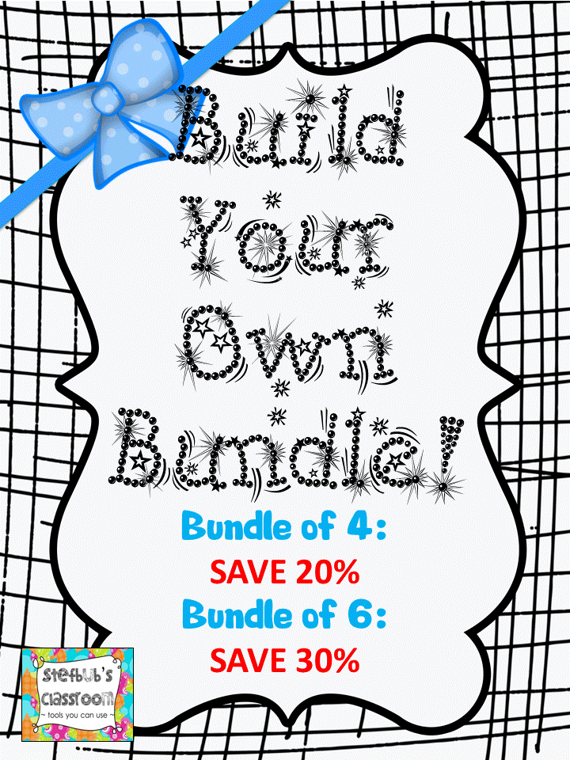
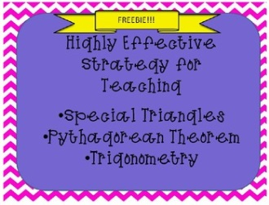
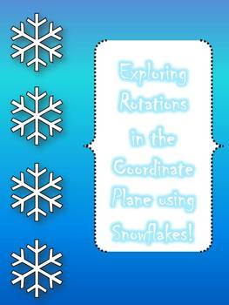
Credits & Terms of use
Thank You
Thank you again for showing interest in my work! Please let me know what you like and what I can do to improve this resource. Remember, if you leave feedback at my store you can earn credits towards future purchases! This download is a single use license and provides you with personal and single classroom use of this product. If you choose to blog/Facebook/pin about using this product, I would love to see it! Feel free to tag me or link back to the product. All pages of this document are copyrighted.
Let’s Connect
Blog
email: stefbub1@gmail.com
You Might Also Like
Credits Background: 3am Teacher, Fonts: www.dafont.com, FunFonts

